Slide 1

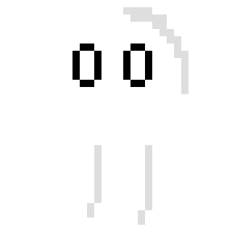
Ghost Prefab
License agreement - Standard Unity Asset Store EULA
License type - Single Entity
File size - 7 KB
Latest version - 1.2
Latest release date - 4/6/2024
Original Unity version - 2017.1.1 or higher
This ghost prefab is meant to be used as an enemy to the playable characters in your game. It is configured by default to move around randomly in a radius after it is spawned/placed. Once it is in range of the player it does a melee attack and bounces back before attacking again. It repeats this behavior until the player is our of range again and it retreats to its original location, resuming the behavior of moving about in a random radius.

